Slide 1

CSE4227 Digital Image Processing
Chapter 8 – Image Fidelity Criteria in Image Compression
Dr. Kazi A Kalpoma
Professor, Department of CSE
Ahsanullah University of Science & Technology (AUST)
Contact: kalpoma@aust.edu
Google Class code: bux3jc2
CSE | AUST
Fall 2023

Slide 2
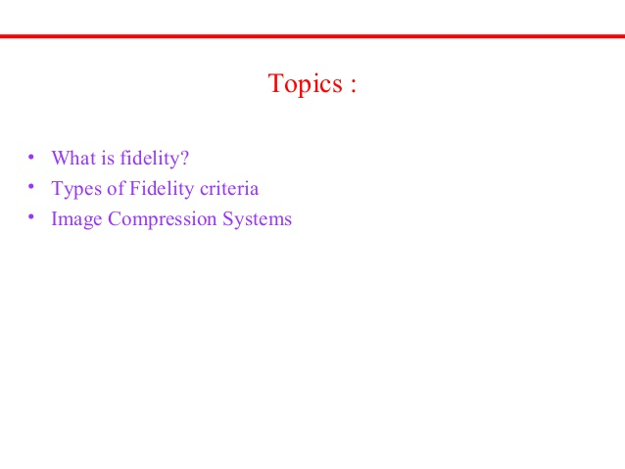

Slide 3

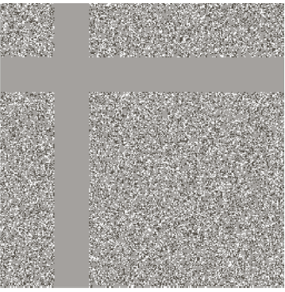
Assessment of loss
removal of irrelevant information removes useful invisible information, too

Slide 4
Assessment of loss
Information is lost in many other compression techniques : Lossy compression
HOW to Assess the loss???

Slide 5
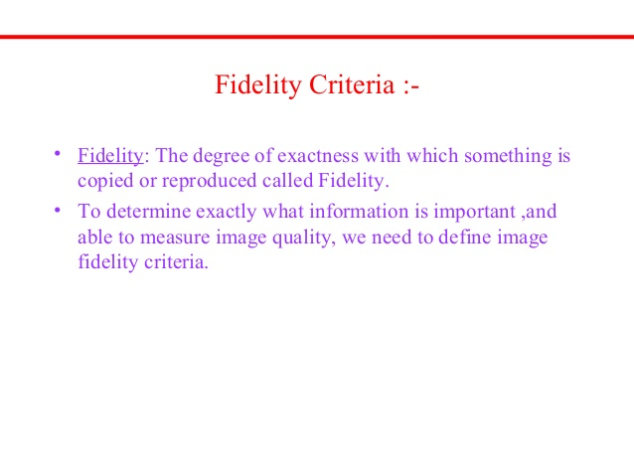
Fidelity criteria can be divided into classes
  Objective Fidelity Criteria
  Subjective Fidelity Criteria

Slide 6
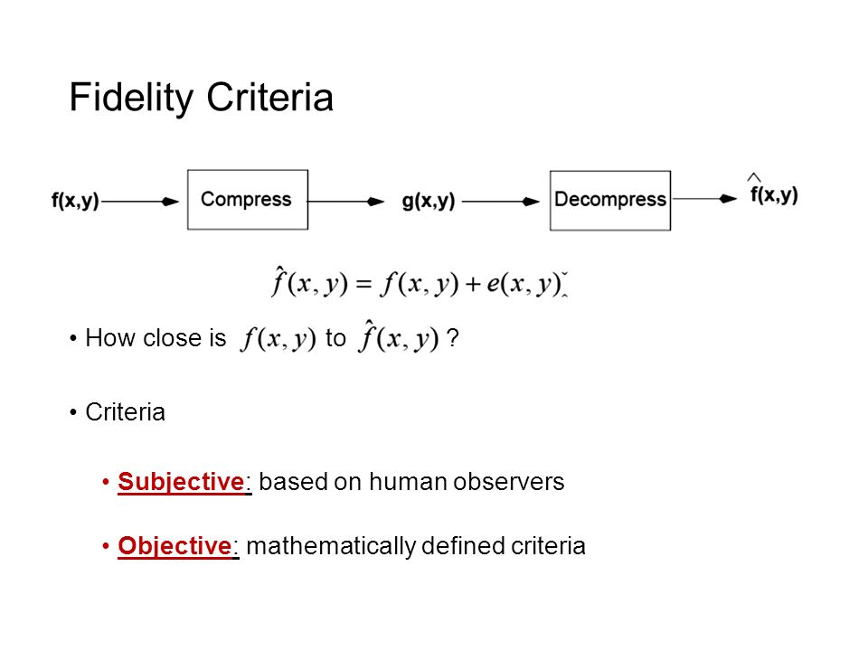
Image Fidelity Criteria
Assessment of loss or infidelity:
Objective fidelity: quantizable
Subjective fidelity: person dependent

Slide 7
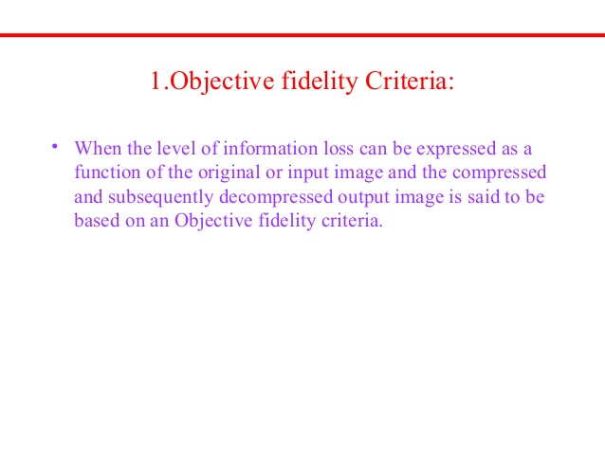

Slide 8
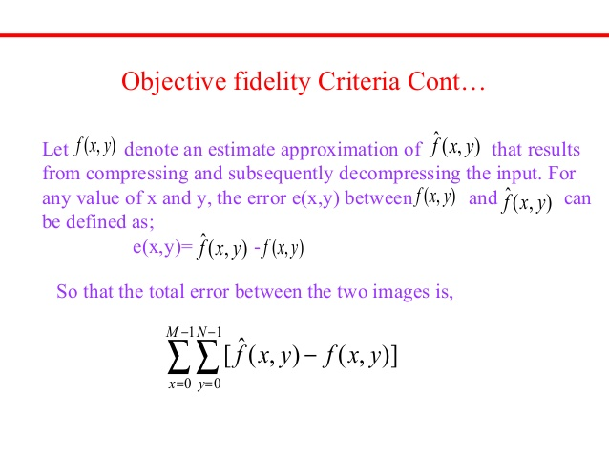

Slide 9
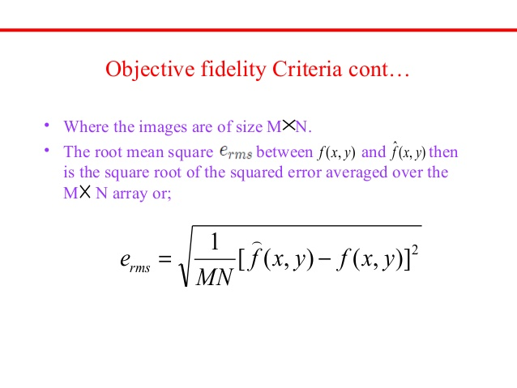

Root Mean Square Error
The smaller the value of root mean square, the better the compressed image represents the original image.

Slide 10
Class Work
Supposed a 3x3 of 3 bits image [1,4,3,5,2,3,4,2,1] is compressed by a Lossy Compression Technique; after the de-compression, image becomes as [3,6,5,7,4,5,6,4,3]. Calculate the Root Mean Square Error as fidelity criteria.

Slide 11
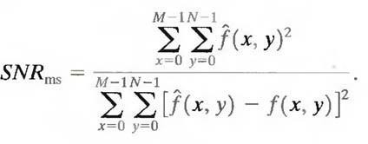
Signal-to-Noise Ratio, SNR_{ms}
A closely related objective fidelity criterion is the mean-square signal-to-noise ratio of the compressed-decompressed image.
If f^ (x, y) is considered to be the sum of the original image f(x, y) and a noise signal e(x, y), the mean-square signal-to-noise ratio of the output image, denoted SNR_{rms}, is
A large number of SNR implies a better image.

Slide 12
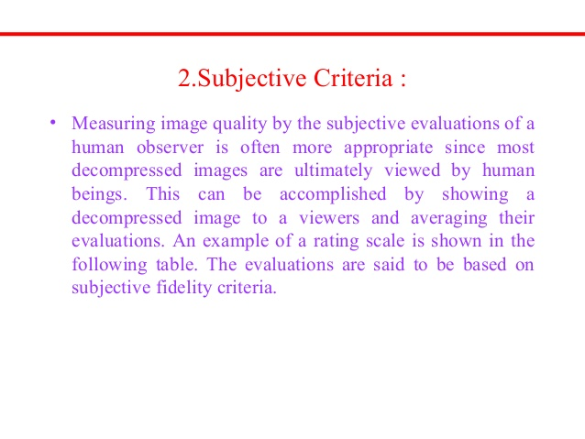

Slide 13
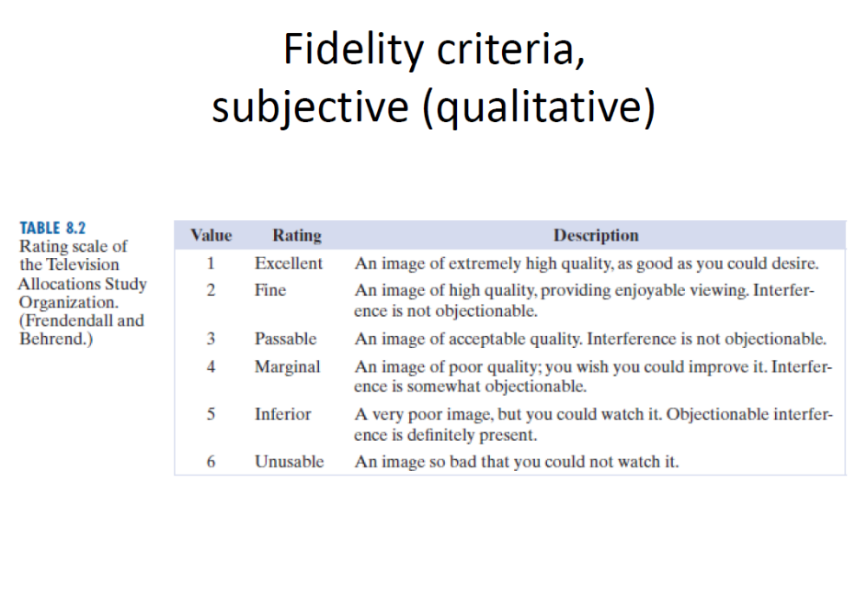

Slide 14
